Slide 1
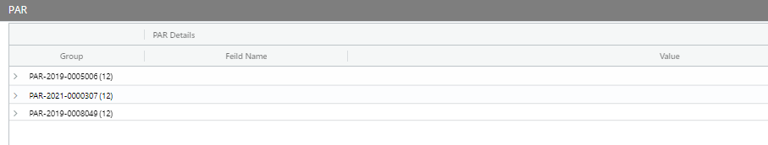
1. Change the default sorting of PAR number as descending order

Slide 2
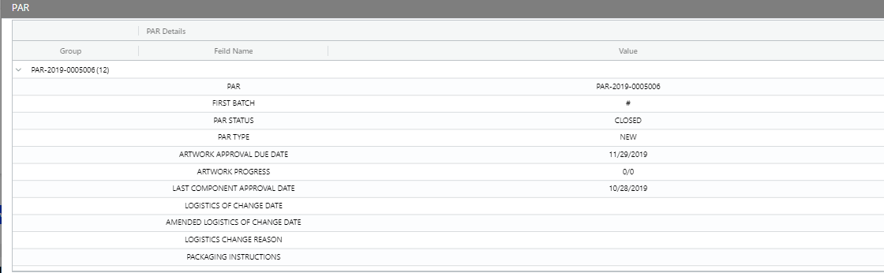
2. Add the component code and component, after “PAR”
E.g. F000000652; PAR-2019-0005006
COMPONENT
FOLDING CARTON ; LABEL ; LEAFLET
COMPONENT CODE
PAA133541 ; PAA133544 ; PAA133543

Slide 3
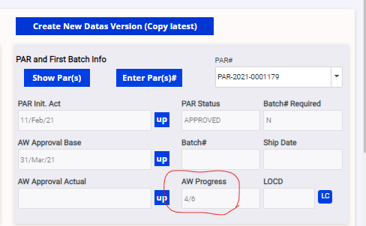
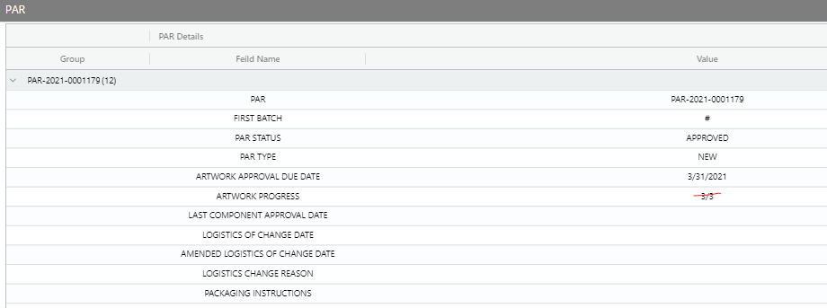
3. Artwork progress all 0/0 for multiple PAR. – apply the same logic as PCM tool
E.g. F000047342; PAR-2021-0001179
4/6

Slide 4
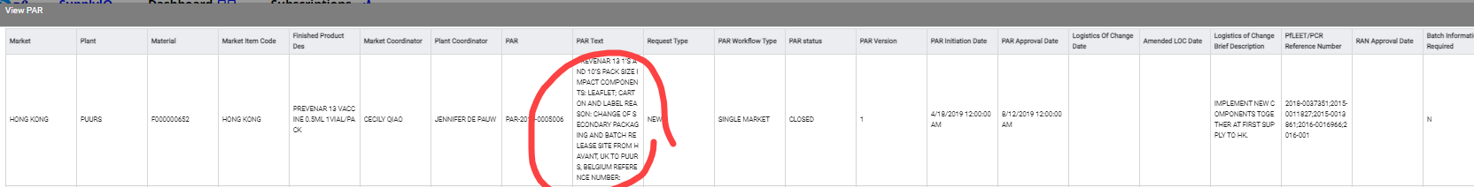
4. Add “PAR text” after the "brief description or comment"
E.g. F000000652; PAR-2019-0005006
User can copy the text in value
PAR text
PREVENAR 13 1’S AND 10’S PACK SIZE IMPACT COMPONENTS: LEAFLET; CARTON AND LABEL REASON: CHANGE OF SECONDARY PACKAGING AND BATCH RELEASE SITE FROM HAVANT, UK TO PUURS, BELGIUM REFERENCE NUMBER:

