Slide 1
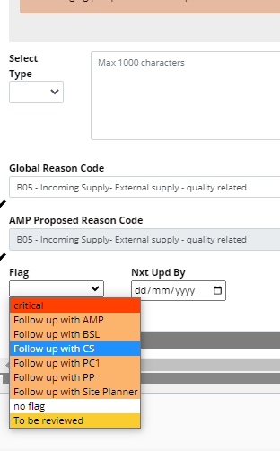
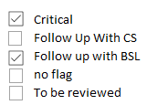
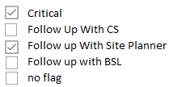

CI – Flag categories in Pulse
Allow to have a the list of Flag Categories that are shown in the dropdown list to be specific by Role
Allow Multiple selection from the Flag Catergory drop down list
Eg AMP role
Eg PP Role
Eg CS Role
Currently
Same Dropdown list for all roles
Only 1 Flag can be selected
After CI
Define dropdown list per role (lists in the slides are just draft examples)
Dropdownlist with Tick-box to allow multiple selection

Slide 2
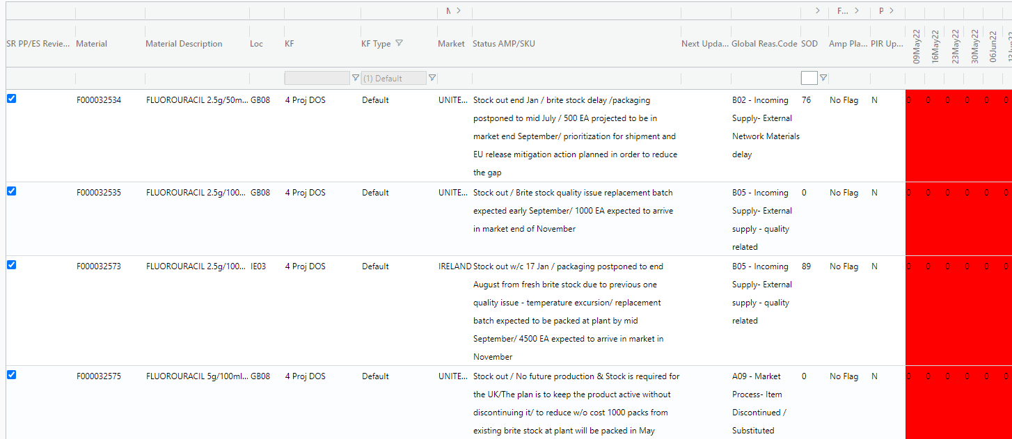
CI – Flag categories in SR Heatmap
Make Flag category an available field on te heatmap (!! Flags are role dependent)
In case a multi-selection is done, the heatmap can indicate “multi-selection”
Flag
Cat.

