Slide 1
PCM INBOX
Integration of eSponsor Sourcing Grid

Slide 2
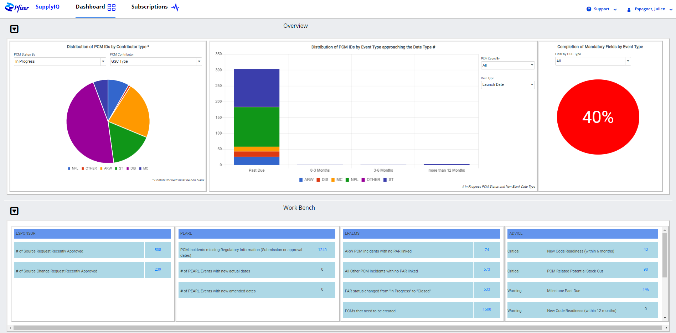

Workbench Connector Details – eSponsor Sourcing Grid
Additional Sourcing Grid Exception to be located at the top in the eSponsor connector
Number highlighted in the hyperlink corresponds to the count of individuals lines in the Open Sourcing Grids
Same action mechanism as other exceptions (click on hyperlink opens the table panel with details)
# of Open Sourcing Grids

Slide 3
Workbench Connector Details – eSponsor Sourcing Grid
Table Layout & Corresponding Actions
Access to exception is the same as the other 2 exceptions of eSponsor ☺
Esponsor ID | Type | Expiry Date | Region | Market | Wave | GRPCODE | GenericName | TradeName | Dosage Form | SecondaryPackagingPlantCode + Secondary PackagingPlant | FinishedProdExpiryDate | Comment
ESP-SG-21-000079 | SG | DD-MMM-YY | AFME | ALGERIA | 2 |  | ABCIXIMAB | ACCUPRIL | CAPSULE - POWDER FILLED | DE52 - FREIBURG | 24 months | Bla bla…
ESP-SG-21-000079 | SG | DD-MMM-YY | AFME | MOROCCO | 3 |  | ABCIXIMAB | ACCUPRIL | CAPSULE - POWDER FILLED | DE52 - FREIBURG | 24 months | Bla bla…
ESP-SG-21-000079 | SG | DD-MMM-YY | AFME | EGYPT | 3 |  | ABCIXIMAB | ACCUPRIL | CAPSULE - POWDER FILLED | DE52 - FREIBURG | 24 months | Bla bla…
ESP-SG-21-000081 | SG | DD-MMM-YY | APAC | SINGAPORE | 1 |  | ACETOMINOPHEN | PRESINEX | CAPSULE | BE37 - PUURS | 36 months | Bla bla…
ESP-SG-21-000081 | SG | DD-MMM-YY | APAC | MALAYSIA | 2 |  | ACETOMINOPHEN | PRESINEX | CAPSULE | BE37 - PUURS | 36 months | Bla bla…
STATUS | EXISTING PCM ID’s | ACTION
Not Yet Created | - | Create / Ignore / Consolidate
Not Yet Created | - | Create / Ignore / Consolidate
Potentially Existing | 12345 | Create / Ignore / Consolidate
Potentially Existing | 12678 | Create / Ignore / Consolidate
Not Yet Created | - | Create / Ignore / Consolidate
Types of Exceptions | Conditions | Corresponding Actions (to be part of the Action drop down) | Action to be defaulted (first choice in the Action drop down)
# of Open Sourcing Grids | Sourcing Grid has an Expiry Date in the future or no Expiry Date (if pas due do not show in the list) REMOVE FROM CONNECTOR once all lines generated have been created/merged or ignored | Create PCM GSC Type = NPL GSC Sub Type = New Molecule / Market Expansion / Line Extension depending on Wave information (1/2/3) Bring “Market” & Corresponding “Region” from our MD & PLACEHOLDER “Brand” (GRP Code will be used to replace the placeholder brand when active later in the year from esponsor feed) Bring Sourcing Grid Esponsor ID + Generic Name + Dosage Form + Finished Product Expiry Date in comment UF1 Bring Comment in the comment section UF2 Update the Project Name to reflect “SG – GENERIC NAME – ESPONSOR ID” Consolidate PCM Look for potential matches based on country / region / GSC Type / Sub Type / Brand Bring Sourcing Grid Reference + Sku denominator in the comment section UF1 (once available) + Finished Product Expiry Date Bring Comment in the comment section UF2 Update the Project Name to reflect “SG – BRAND – SGID” Ignore record | Create PCM

Slide 4
Workbench Connector Details – eSponsor Sourcing Grid
Pontential Phasing of Activities
Tasks | Dates | Immediate / Dependent
Create the exception | 22NOV21 | Immediate
Create the table | 22NOV21 | Immediate
Create placeholder for action buttons (activate later once data holds sku denominator details) | 22NOV21 | Immediate
User deployment | December
Review of existing Grids | December
Ingestion of new modified data from eSponsor | 3 weeks | Dependent
Activation of the user actions | 3 weeks | Dependent

Slide 5
Workbench Connector Details – eSponsor Sourcing Grid
Conversation with Patrick & Notes
will there be any indication of the dosage and pack size to allow us to derive the sku's taht are going to launch?
Drop down values coming from brand maintained in EAH
Also allowing for manual entry if brand is not there yet
15-16 open sourcing grids
is the brand going to be standardized based on master data coming from SAP or SCD ?
Field used in EAH is the API
Next release for end of the year, will be including the Global Reporting Product
Could be amended on open sourcing grids
is the "all market" selection meant to stick around? If so, does that we should create new launches for 100+ markets at one time ?
Release 4 will integrated the SCD regional hierarchy 😊
The “All market” row can be ignored, as all lines would be created for the “all markets” within a region….line duplication is taken care of in eSponsor
I guess for the SG we do not seem to have a status, do we assume it's all valid for users consume the moment it's made available in Esponsor?
No status, just open or closed….considered open until expiry date is not reached
Expiry date is the limit for market to raise their interest to be included
Owner has an option to extend the expiration date
After that market keen to launch will have to raise an SR
Sourcing Grids is fed by the NPSR…markets listed in the NPSR can be added automatically when creating the grid.
What does the expiry date corresponds to? Is this the drop dead date by when users can no longer create laucnhes ?
Talk to Leticia and Eduardo about the practice of raising SR to get materials created…even outside the regular NPL process ???
Reach out to Denis to discuss the sku level details…or at least something that helps figure out how many skus and roughly what they are…

