Slide 1
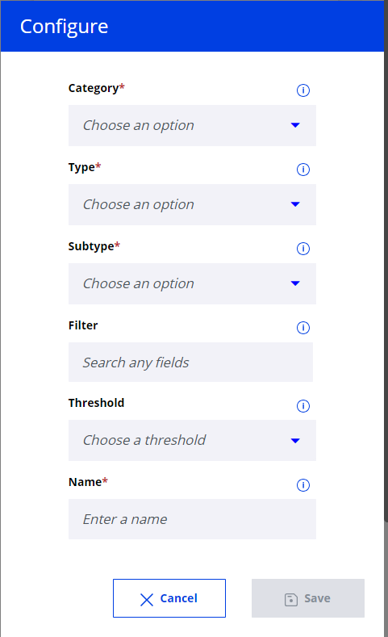
Pending MOT change
Show the number of pending requests in the summary. Clicking on the number should show SKU wise actions for review and approving the MOT requests
All CS, AMP and LNO users. More than 1000 number of Critical shipments executed until now. This will help in speeding up MOT change for critical shipments
1. Configuration
Pending MOT change
Pending Ocean/Road -> Air Request
Disabled if this category is chosen
(Type/Subtype values & disabled should be configured from backend table
User View drop down
Threshold drop down
Free Text. E.g. “My APAC MOT requests”

Slide 2
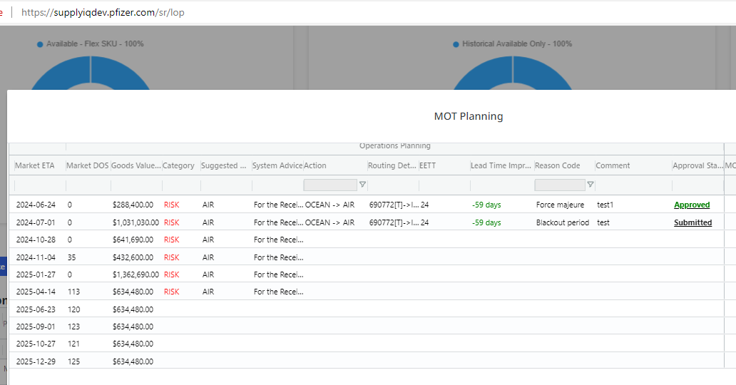
1. Summary
Number of requests with Action:
Ocean -> AIR
Road -> AIR
In statuses:
Submitted
Not Submitted
Returned
Cancelled
10
My APAC MOT Request
Pending MOT change
Name defined by User
Category name

Slide 3
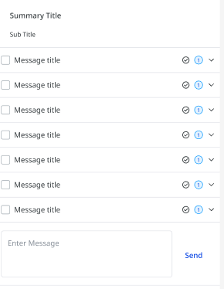
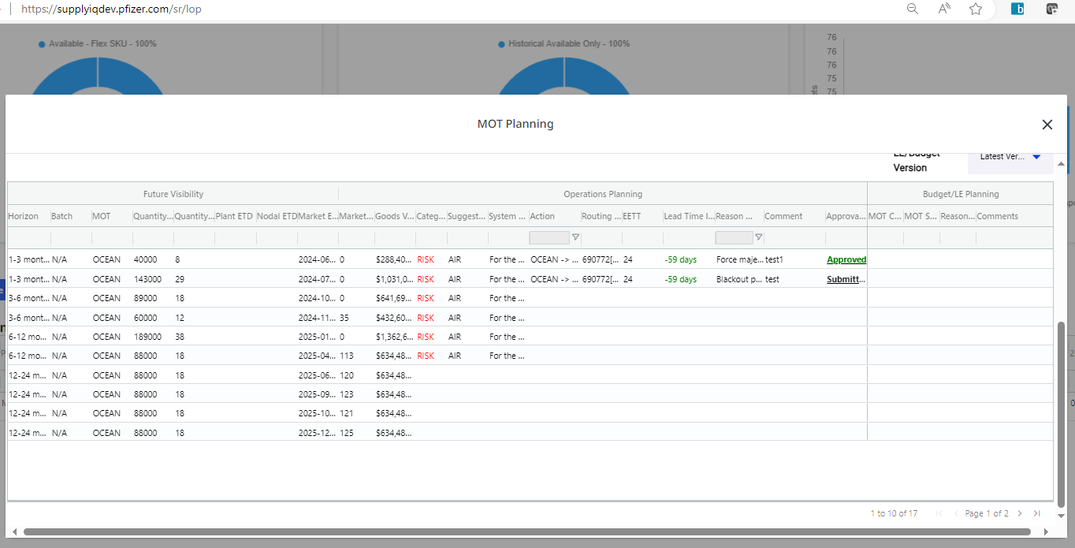
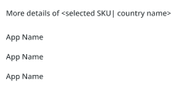
2. Detailed view
Name defined by User
Category name (Pending MOT change)
Material | Location | Market ETA
My APAC MOT Request
When click on expand, detailed view is presented:
Material | Location | Market ETA
When click on “check” it should turn green and with next refresh notification related to this Material – Loc. – ETA should not be presented to the User. By clicking notification popup: “You confirmed notification as read. It will not be presented to you anymore” And user has options: “OK” and “Cancel” to confirm or cancel action.
Material – Material Desc. - Location
Ocean to Air / Road to Air | Ocean to Air
Status | Submitted
Quantity (EA) | 15000 (EA)
Quantity (Pallets) | 5 (Pallets)
Market ETA | 2024-09-01
Lead Time Improvement | 17 (days)
Comment | Text (short + tooltip on click)
Hyperlink | Hyperlink to sr/lop
Material | Location | Market ETA
Material | Location | Market ETA
Material | Location | Market ETA
Not MVP functionality, do not present “check” button
Material | Location | Market ETA
Material | Location | Market ETA
Material | Location | Market ETA
Hyperlink to Material – Location (it will present full horizon and all shipments related to Material – Location)
When user clicks on box it become checked and “More details” section is activated below:

Slide 4
Ocean Opportunities / Air Risks
For the portfolio selected, user needs to see the number of SKUs that can be moved to ocean based on Opportunity advice. In the expanded view, the SKUs/shipments have to be broken down by horizon
1. Configuration
Ocean Opportunities / Air Risks
Pending Ocean/Road -> Air Request
Type 1: Risk
Type 2: Opportunity
Disabled if this category is chosen
(Type/Subtype values & disabled should be configured from backend table
User View drop down
Threshold drop down
Free Text. E.g. “My APAC MOT Risks”

Slide 5
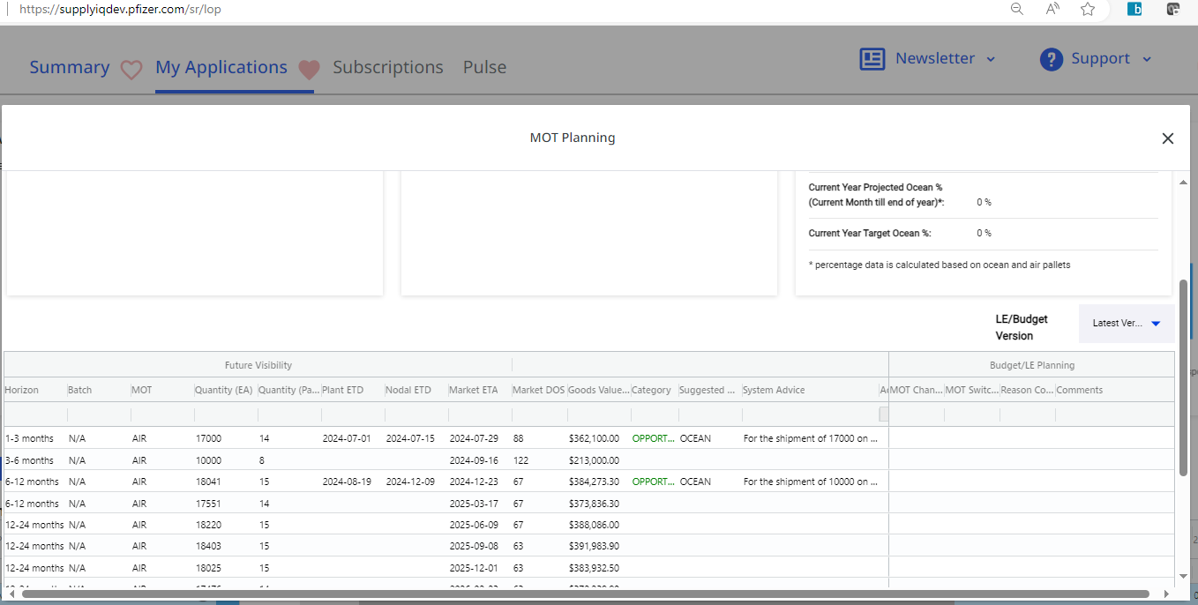
1. Summary
Number of requests with Category:
Opportunity
or
2) Risk
Dependent on what was selected by user as a Type when configurate Summary
10
My APAC MOT Opportunities
Ocean Opportunities / Air Risks
Name defined by User
Category name

Slide 6
2. Detailed view
Name defined by User
Category name (Ocean Opportunities / Air Risks)
Material | Location | Opportunity
My APAC MOT Opportunities
When click on expand, detailed view is presented:
Material | Location | Opportunity
When click on “check” it should turn green and with next refresh notification related to this Material – Loc. – ETA should not be presented to the User. By clicking notification popup: “You confirmed notification as read. It will not be presented to you anymore” And user has options: “OK” and “Cancel” to confirm or cancel action.
Material – Material Desc. - Location
Quantity (EA) | 15000 (EA)
Quantity (Pallets) | 5 (Pallets)
Market ETA | 2024-09-01
Suggested MOT | Ocean
System Advice | Text (short + tooltip on click)
Action | Text (short + tooltip on click)
Comments | Text (short + tooltip on click)
Hyperlink | Hyperlink to sr/lop
Material | Location | Opportunity
Material | Location | Opportunity
Material | Location | Opportunity
Not MVP functionality, do not present “check” button
Material | Location | Opportunity
Material | Location | Opportunity
Material | Location | Opportunity
Hyperlink to Material – Location (it will present full horizon and all shipments related to Material – Location)
When user clicks on box it become checked and “More details” section is activated below:

