Slide 1
Open Alerts Count
DAILY REFRESH
For the Summary KPI card: number of Open Alerts, based on:
- Status = "Open"
- User profile (For a generic user without product/site responsibility assigned in the system, show all open alerts. For a user with product/ site / BU responsibility, only show the relevant subset of open alerts)
For Quick View Table: high level table with key fields:
- Alert ID (hyperlinked)
- Supply Alert Level
- Status
- Title
- Product
- Regions
- Market
- Primary Root Cause
- FG site
- Alert Creation Date
- Alert Version Number
- Alert Last Review Date
Quick Actions:
- for profiles with Alert read only credentials (no quick action, only hyperlink to consult the full alert in module)
- for profiles with Alert creation credentials (BSL, PPL, AMP Team Lead, AMP Senior Planner)...would suggest same as previous (take them to the full blown SA page if they have to do modification and publish a revision)

Slide 2
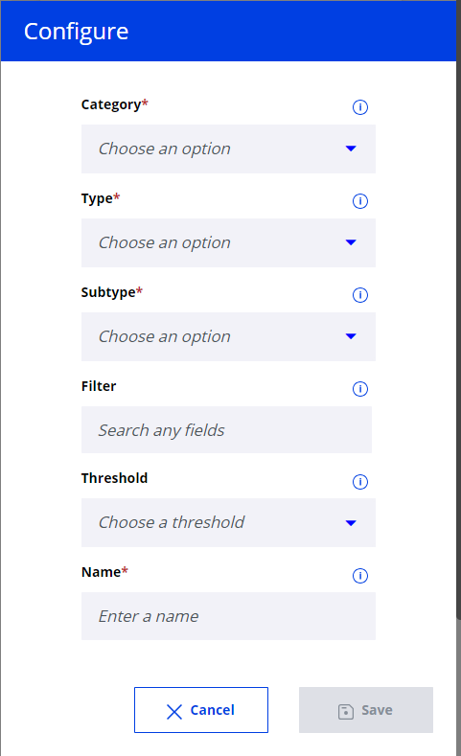
1. Configuration
Open Supply Alerts Count
Disabled if this category is chosen
(Type/Subtype values & disabled should be configured from backend table
Integrate table of user’s configured Alerts Subscriptions on ID level
User View drop down -> Replace with NTID info / subscriptions customized by User
Threshold drop down (not needed – to be disabled)
Free Text. E.g. “My APAC Open Supply Alerts”

Slide 3
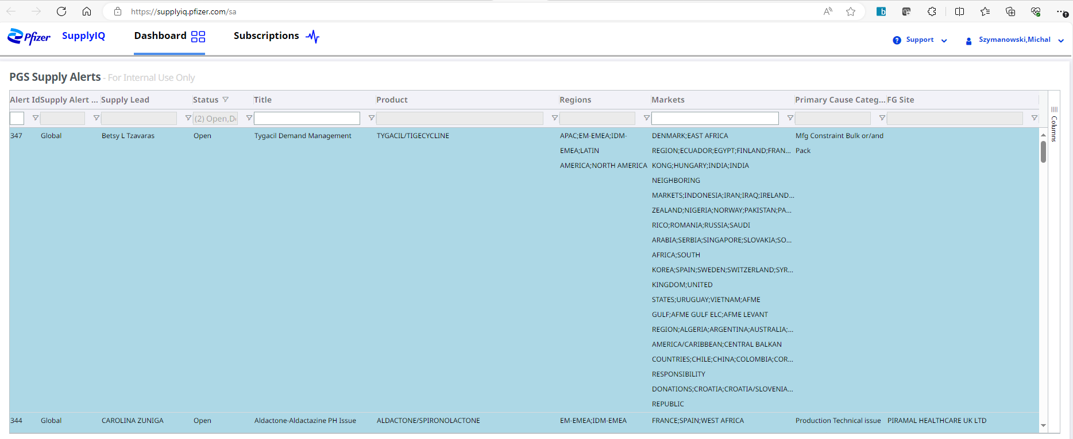
1. Summary
Number of Alerts in Statuses:
Open
Valid criteria to identify portfolio (View):
Based on Subscriptions on ID level
(User Views not needed)
10
My APAC Open Alerts (APAC)
Open Supply Alerts Count
Name defined by User
Category name

Slide 4
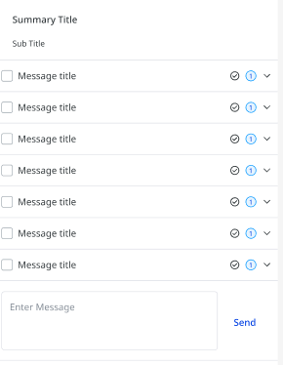
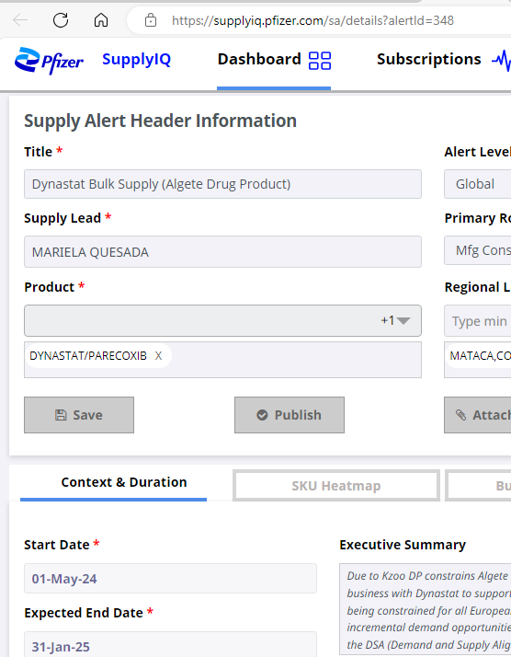
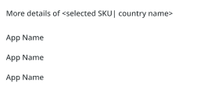
2. Detailed view
Name defined by User
When click on expand, detailed view is presented:
Category name (Open Alerts Count)
Alert ID | Title
Sorted by Modified Date
- Alert ID (hyperlinked) | https://supplyiq.pfizer.com/sa/details?alertId=339
- Supply Alert Level | Local / Regional / Global
- Title | given by person who logged (free text)
- Product | multiple can be added
- Regions | multiple can be added
- Market | multiple can be added
- Primary Root Cause | drop down
- Start Date
- Expected End Date
- Supply Lead
- FG site | multiple can be added
- Alert Creation Date
- Alert Version Number | where to find? Follow up with Velu?
- Alert Last Review Date | modified date
Alert ID | Level | Title
Alert ID | Level | Title
Alert ID | Level | Title
Alert ID | Level | Title
Alert ID | Level | Title
Alert ID | Level | Title
Alert ID | Level | Title
When user clicks on box it become checked and “More details” section is activated below:

