Slide 1
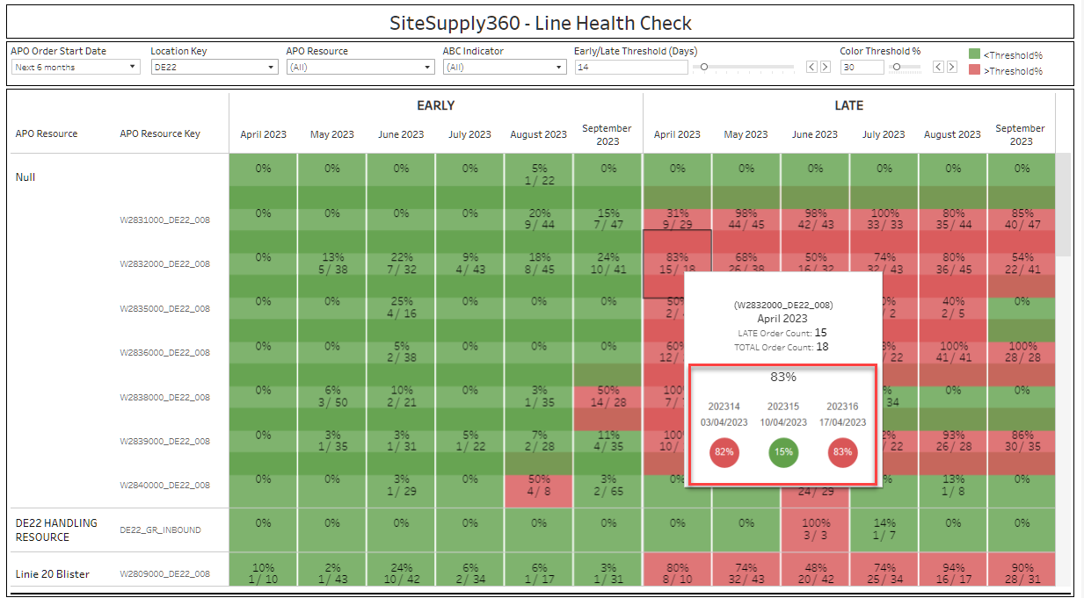
Enable a comparison indicator between current week and previous week as a trend can indicate if more immediate action is needed or not. Hover over pop up with current week and previous2 weeks

Slide 2
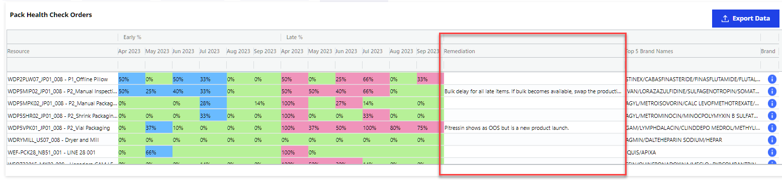
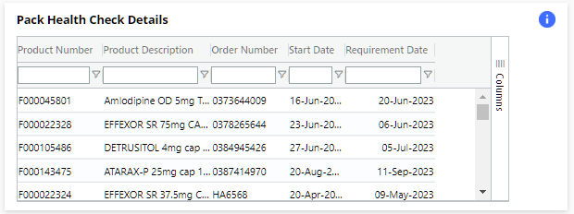
Make the comments from the resource level in the pack Health check visible in the widget on the Plant SR dashboard

Slide 3
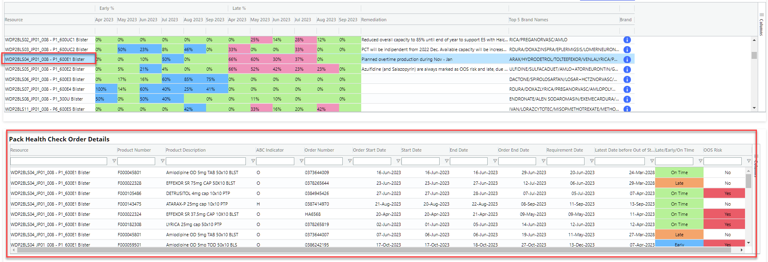
Improve the double click on the Grid to show the details of the orders. If the double click is on the Resource (line level) show all orders in the detail view; but if an individual monthly bucket is selected, only show the orders relevant for that month
Click resource
All orders showing

Slide 4
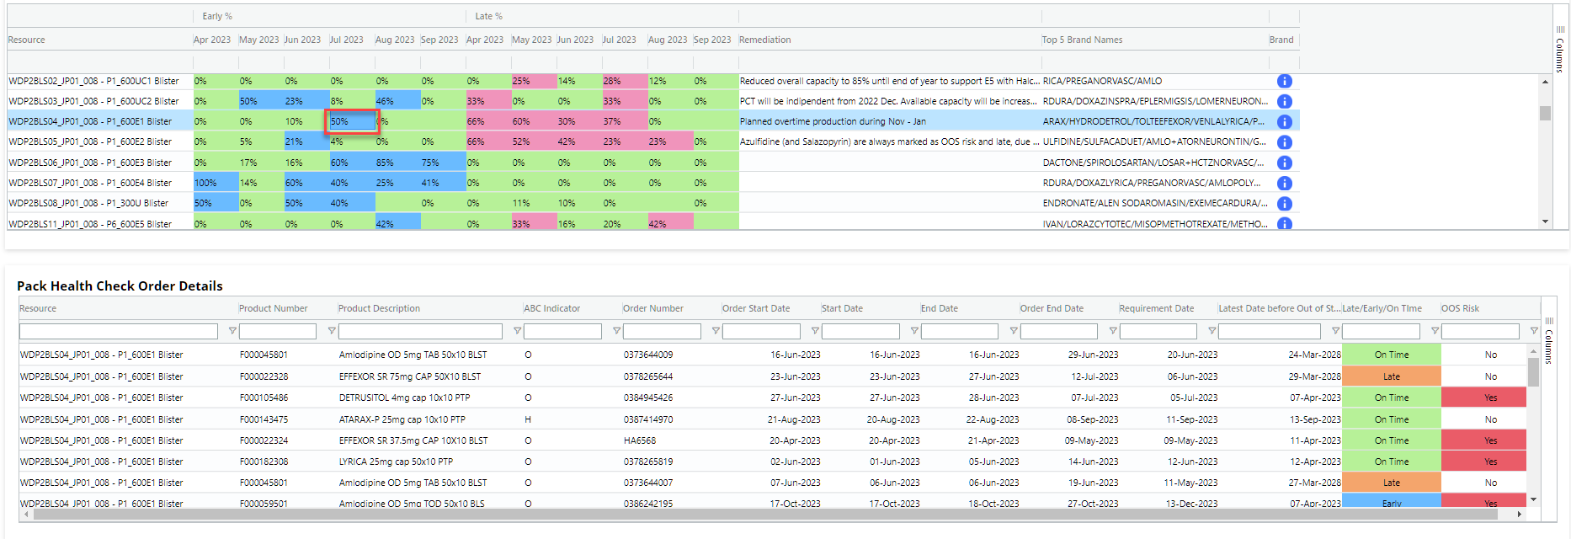
Click monthly bucket
Show orders with a start date in that month

