Slide 1
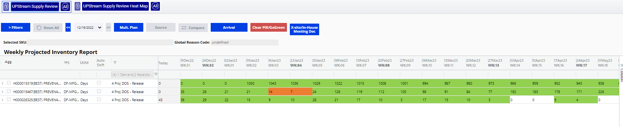

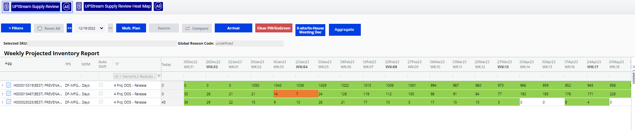
Clear Aggregation
Tick box for selecting materials to be aggregated
‘Aggregate’ / ‘Clear Aggregation’ buttons
Clear Aggregation

Slide 2
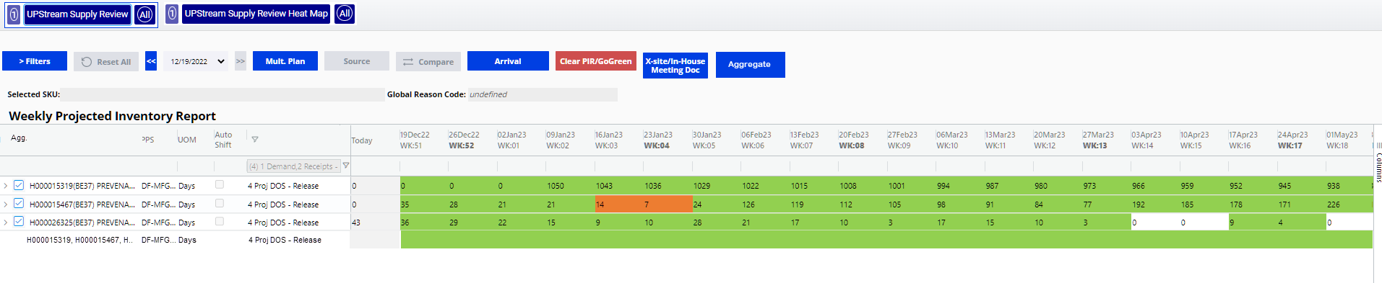
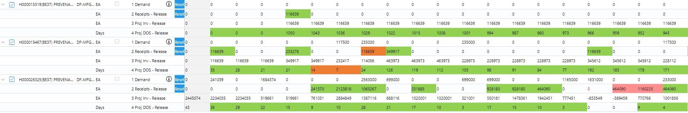
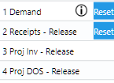
Minimized view – total projected DOS for all aggregated SKUs
Clear Aggregation
A
71 | 57 | 43 | 1086 | 1066 | 1053 | 1081 | 1169 | 1151 | 1130 | 1109 | 1109 | 1093 | 1074 | 1053 | 1158 | 1144 | 1139 | 1120
Identifier
Expanded view – all key figures aggregated
A
241039 | 0 | 1684374 | 0 | 0 | 117500 | 2798000 | 699000 | 0 | 0 | 934000 | 699000 | 0 | 0 | 1165000 | 1631000 | 0 | 0 | 350500
116639 | 0 | 0 | 349917 | 241370 | 2123818 | 1181906 | 349917 | 331885 | 0 | 0 | 928180 | 928180 | 464090 | 0 | 116639 | 464090 | 1160225 | 464090
2320674 | 2320674 | 636300 | 986217 | 1227587 | 3233905 | 1617811 | 1268728 | 1600613 | 1600613 | 666613 | 895793 | 1823973 | 2288063 | 1123063 | -391298 | 72792 | 1233017 | 1346607
71 | 57 | 43 | 1086 | 1066 | 1053 | 1081 | 1169 | 1151 | 1130 | 1109 | 1109 | 1093 | 1074 | 1053 | 1158 | 1144 | 1139 | 1120
Aggregated SKUs greyed and locked to allow for further aggregated groupings

Slide 3
A
241039 | 0 | 1684374 | 0 | 0 | 117500 | 2798000 | 699000 | 0 | 0 | 934000 | 699000 | 0 | 0 | 1165000 | 1631000 | 0 | 0 | 350500
116639 | 0 | 0 | 349917 | 241370 | 2123818 | 1181906 | 349917 | 331885 | 0 | 0 | 928180 | 928180 | 464090 | 0 | 116639 | 464090 | 1160225 | 464090
2320674 | 2320674 | 636300 | 986217 | 1227587 | 3233905 | 1617811 | 1268728 | 1600613 | 1600613 | 666613 | 895793 | 1823973 | 2288063 | 1123063 | -391298 | 72792 | 1233017 | 1346607
71 | 57 | 43 | 1086 | 1066 | 1053 | 1081 | 1169 | 1151 | 1130 | 1109 | 1109 | 1093 | 1074 | 1053 | 1158 | 1144 | 1139 | 1120
Further aggregation

Slide 4
Logic
When ‘Aggregate’ button is selected, key figures displaying sum of all selected SKUs in PIR created
Checked materials greyed out and locked from further aggregation
Further selection of materials will be treated independently when aggregate button is selected – 4 new line items (demand, receipts, inv, DOS) in addition to previous aggregation
‘Clear Aggregation’ will remove all aggregated lines and return PIR to original state
Open Questions
Meeting doc – do all materials plus aggregated SKUs show in meeting doc?
Limiting aggregation functionality to specific PPS (MFG)?
Receipt colouring – no colouring on aggregated view
UOM – same unit of measure initially

